Slide 1

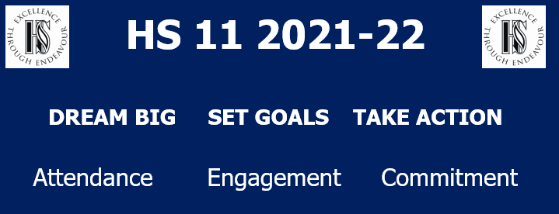
H S 11
Year 11
Information Evening
21st March 2024

Slide 2
Getting the basics right
This Evening
Year 11 Support
Exam timings
Exam processes
Post 16

Slide 3
Getting the basics right
At school
Attend & Engage with:
Lessons
Support sessions
Keep Tutors aware

Slide 4
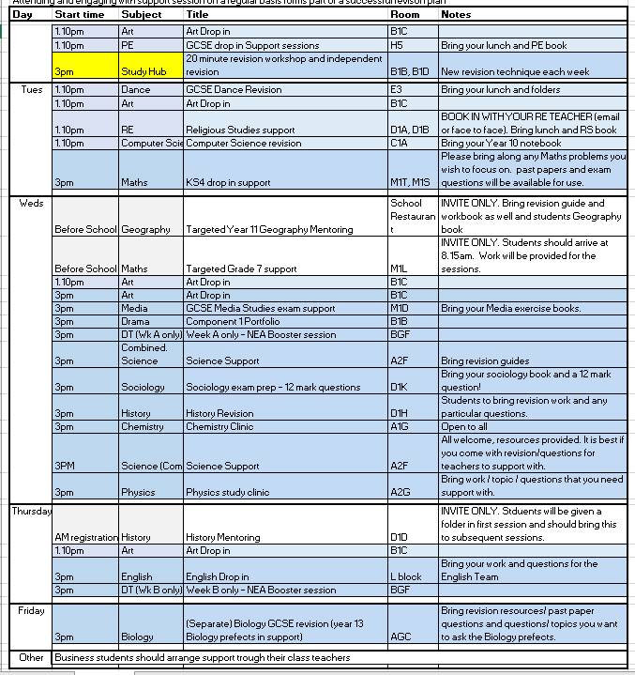

Slide 5

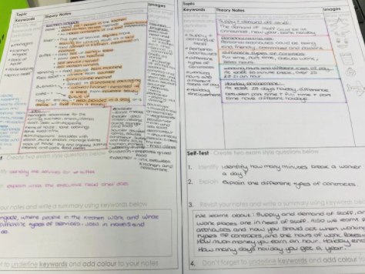
Notable mentions
Elevate – Monday 15th April
Mentoring scheme – Ongoing to build momentum..
Revise Like a Pro - Videos online…
Revision Strategy of the week – Assembly
Revision Timetables – Still online, used by many…

Slide 6
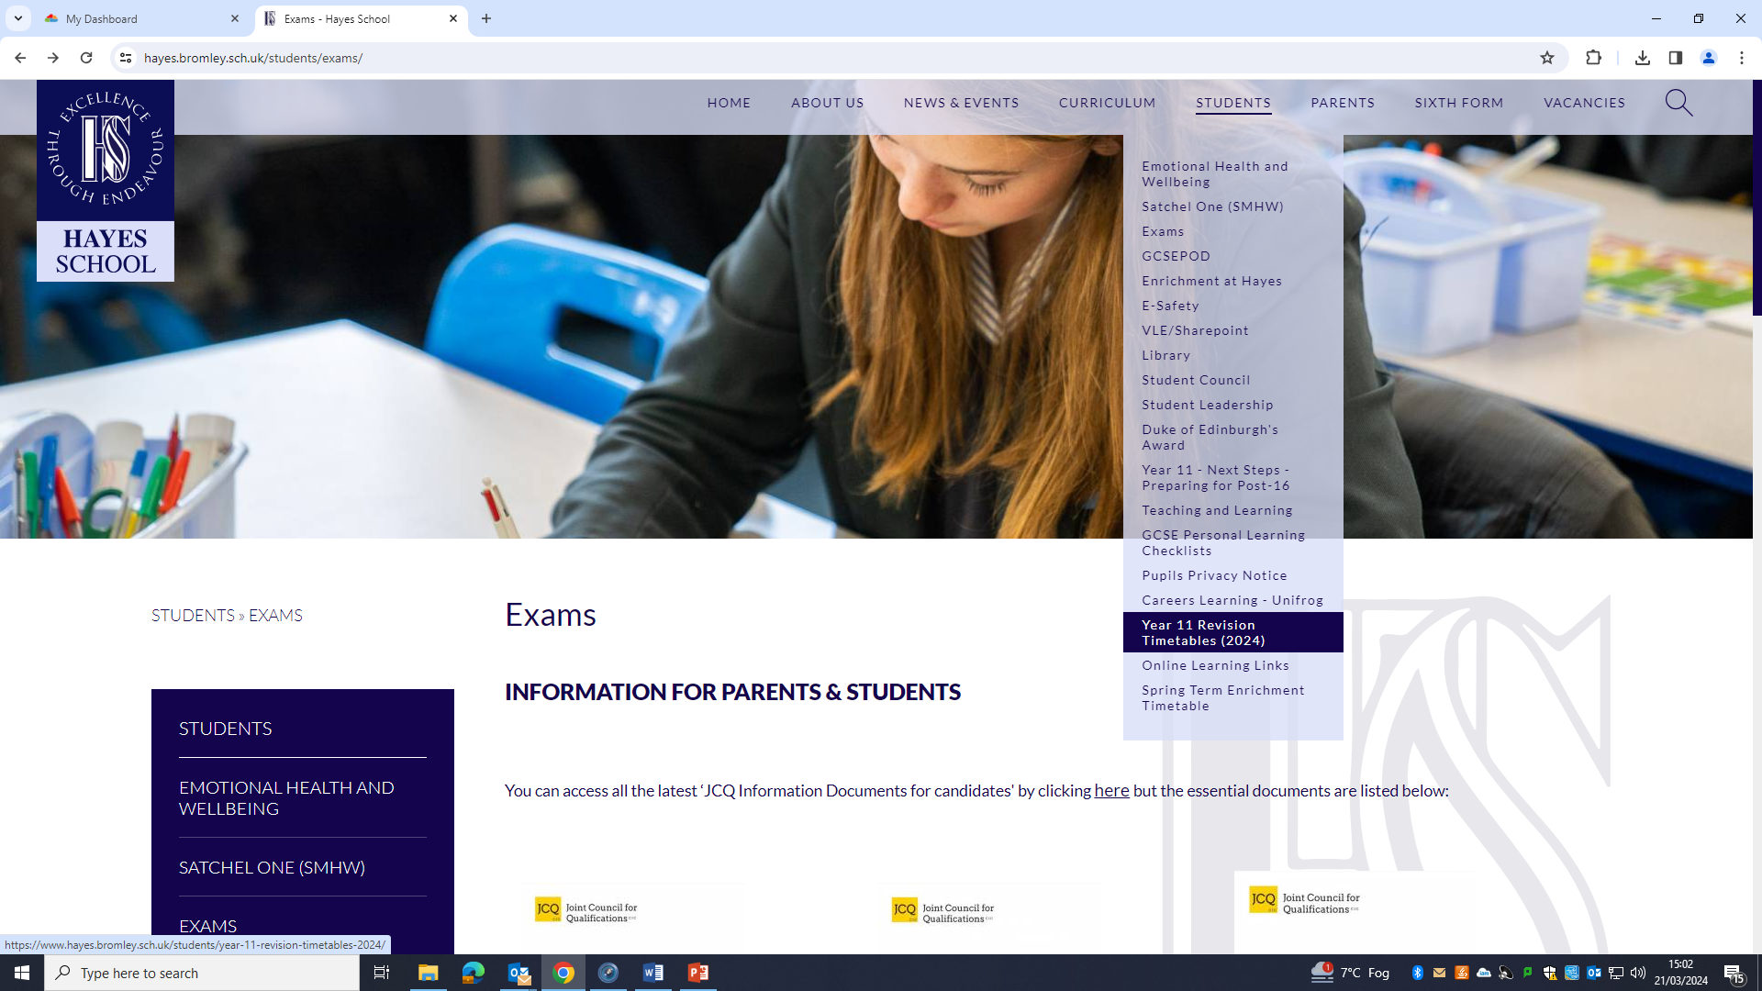

Slide 7
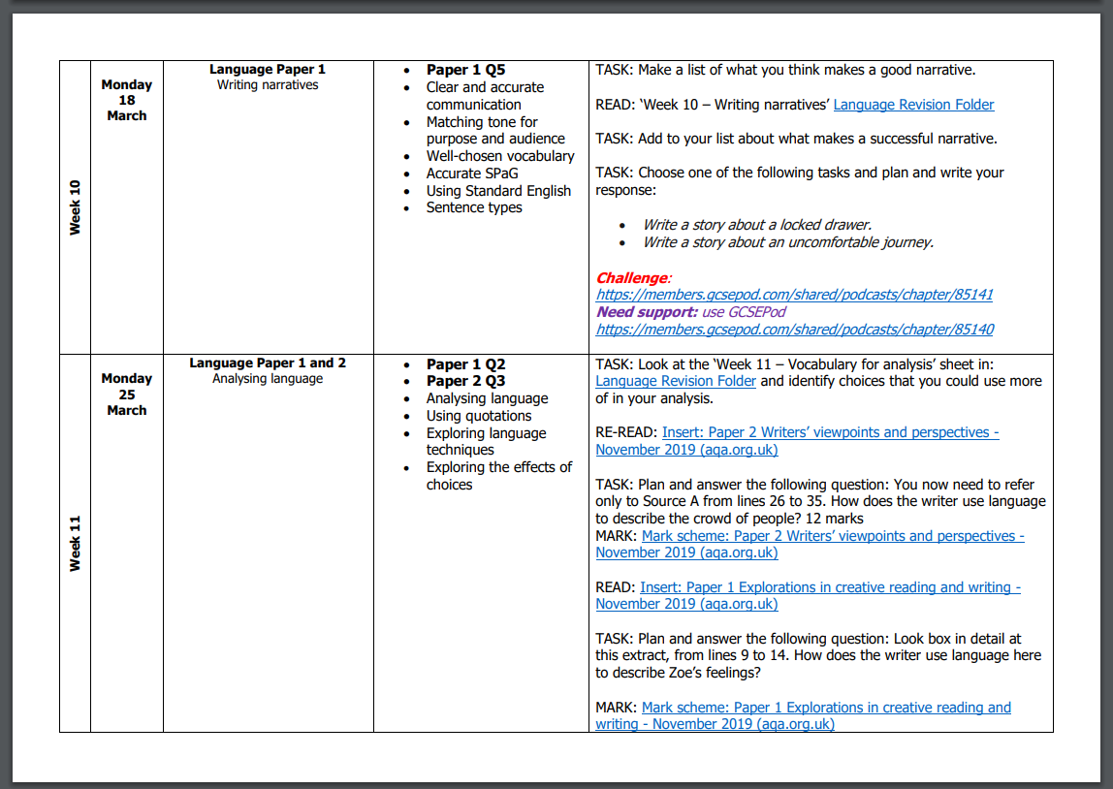

Slide 8
Getting the basics right
At home
- Environment
- Planning
- Implementation intentions.
- Keep talking – stress and anxiety is natural

Slide 9
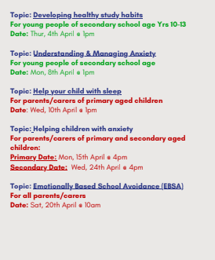
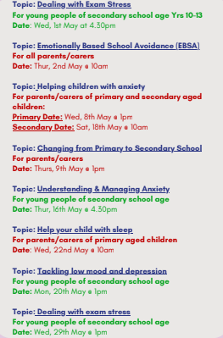

Slide 10

Using the Mock Exams
Using the Mock Exams
Feedback capture sheets
Grades released
W/C 25th March

Slide 11
Using the Mock Exams
The Knowledge or Exam Technique that I need to improve is…. | How will I improve?
Where can I find support? (Clubs, study sessions, work with a study partner):
Notes:

Slide 12
EASTER SCHOOL
EASTER SCHOOL
We are running Easter revision sessions for some subjects on Wednesday and Thursday of the 2nd week of the Easter break.
Most sessions are targeted at specific groups of students and departments may make contact with individuals to invite them to the sessions. In addition, there will also be a study hub available to students who wish come and study in a purposeful environment with friends
Please contact the Head of Department for more details
Details on how to sign up to these sessions will be sent shortly.

Slide 13
EASTER SCHOOL
DATE OF PROVISION | SUBJECT | LEVEL OF STUDY | WHICH STUDENTS SHOULD COME TO THIS SESSION? | TOPIC / AIM OF THE SESSION | SESSION TIME
Wednesday 10th April; | STUDY HUB | GCSE & A-LEVEL | All Year 11s and Year 13s | Private Revision | 9am - 2pm
Wednesday 10th April; | Geography | GCSE | Year 11 students looking for grade 5 upwards | To enable Year 11s to achieve grade 6 or better | 9am - 11am
Wednesday 10th April; | Chemistry - Combined | GCSE | Year 11 Combined Science Chemists | Exam technique: Securing a grade 55 | 10am - 12pm
Wednesday 10th April; | Sociology | GCSE | Year 11s looking to secure 7 to 9 grades | 12 mark essay 'discuss' questions. | 10am - 12pm
Wednesday 10th April; | D&T | GCSE | Those behind on their NEA who risk missing target grade. |  | 10am - 2pm
Wednesday 10th April; | Chemistry - Separate | GCSE | Year 11 Separate Chemists | Exam Technique | 10am - 12pm
Wednesday 10th April; | Spanish | GCSE | Year 11 Foundation | Spanish speaking practice | 10am - 11am
Wednesday 10th April; | Spanish | GCSE | Year 11 Higher | Spanish Speaking practice | 11am - 12pm
Wednesday 10th April; | French | GCSE | All Year 11 Higher & Foundation | Conversation & 90 word writing | 12pm - 1pm
Wednesday 10th April; | French | GCSE | All Year 11 Higher only | Photo card / 150 word writing | 1pm - 2pm

Slide 14
EASTER SCHOOL
DATE OF PROVISION | SUBJECT | LEVEL OF STUDY | WHICH STUDENTS SHOULD COME TO THIS SESSION? | TOPIC / AIM OF THE SESSION | SESSION TIME
Thursday 11th April; | STUDY HUB | GCSE & A-LEVEL | All Year 11s and Year 13s | Private Revision | 9am - 2pm
Thursday 11th April; | Combined Science Biology | GCSE | Year 11 Combined science biologists | Key ideas and skills | 9am - 11am
Thursday 11th April; | Biology | GCSE | Separate Biology Students | Tricky Content from Separate Science - Biology | 9am - 11am
Thursday 11th April; | History | GCSE | All Year 11 students | Germany and Cold War papers | 10am - 12pm
Thursday 11th April; | Sociology | GCSE | Year 11s looking to secure a grade 5 or more | Exam skills | 11am - 1pm
Thursday 11th April; | Combined Science Physics | GCSE | Year 11 Combined science physics | 6 Key Concepts for Physics (GPE/KE, potential difference/current, gas pressure, half life, terminal velocity, waves on a ripple tank) | 12pm - 2pm

Slide 15
The exam season
The Exam period starts: w/c 6th May.
Announced to students last week.
The proper ‘Timetable’ to follow.
The Final exam is scheduled to be : 18th June
MFL speaking assessments and Art exams will fall before the 6th.

Slide 16
Further guidance - Exams
Exam clashes: We are aware that some students have 'clashes', as in they have two exams scheduled for the same sitting. This affects about 30 students and requires additional guidance and invigilation. We are taking advice now and know who these students are.
Every affected student will receive letter detailing when both exams will be sat.
In most cases, this will mean that the students sits both exams on the same day.
What if your child is unwell?
Try as hard as you can to get them in! The 6th form will be made aware.
There is no opportunity to re- sit individual units, only the entire set of units in a later exam series.
Exam boards try to space exams in each subject, so illness affects fewer units in each subject.

Slide 17
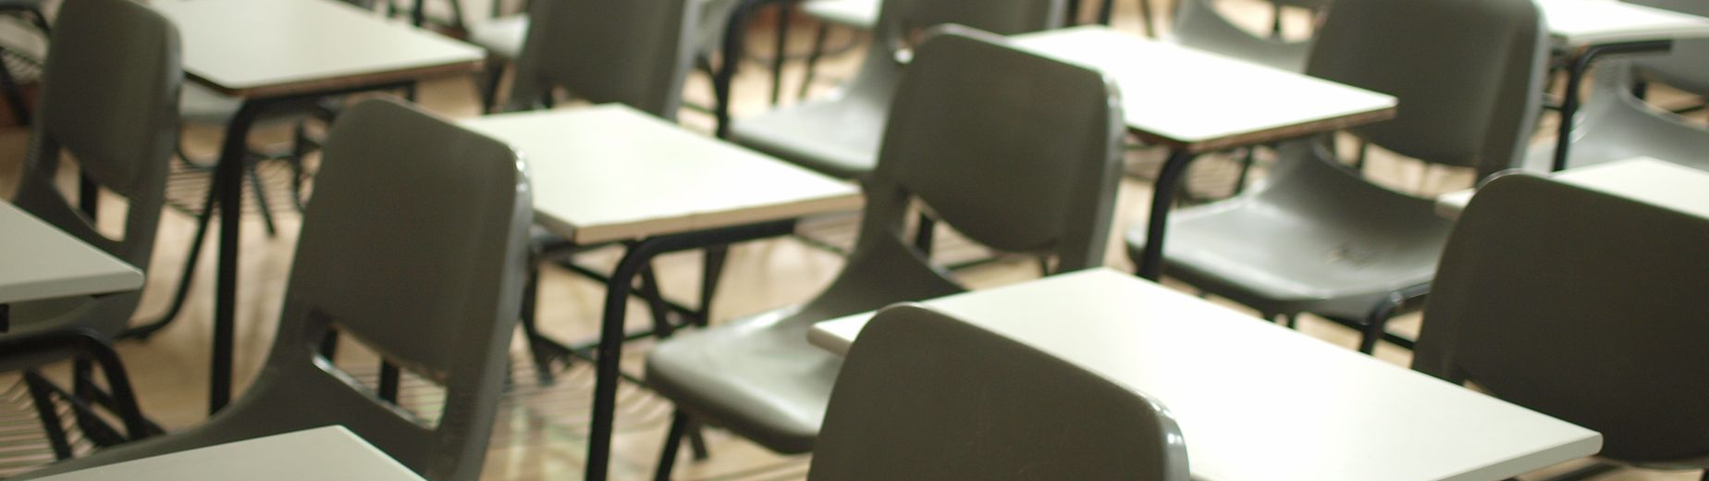

Examinations
Important information for candidates, parents and carers

Slide 18
Key principles
All examination centres, including schools and colleges MUST ensure that they are compliant with the published regulations for exams as set out by JCQ and the exam boards
There are therefore rights and responsibilities for exam boards, staff working in school and candidates
There are procedures which must be followed where there is reason to suspect that regulations may have been broken, including investigation into suspected malpractice
All must ensure:
* Public confidence in exams and qualifications
* Integrity of assessment and qualifications
* Validity of results and certificates
* No candidates are prejudiced
* The authority, reputation and credibility of organisations are
maintained

Slide 19

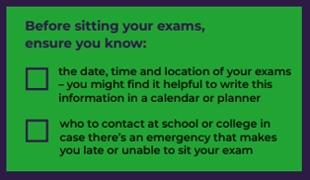
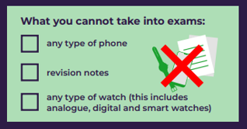
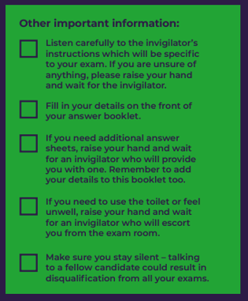
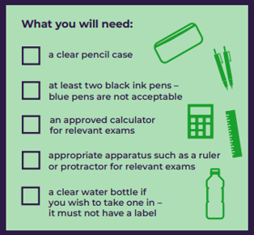

Information for candidates - written examinations and on-screen tests
examsofficer@hayes.bromley.sch.uk

Slide 20








CANDIDATE MALPRACTICE
Examples of malpractice - things which are not permitted
Failing to follow instructions or advice of
invigilators in respect of rules and
regulations
Disruptive behaviour in the examination
room (including use of offensive language)
Accessing the internet or online materials
during remote assessment where this is not
permitted
Allowing others to assist in the production
of controlled assessment, coursework,
non-exam assessment (NEA) or the
contents of a portfolio
Collusion: working collaboratively with
other candidates beyond what is permitted
Bringing notes into the exam in the wrong
format, (where notes are permitted)
including inappropriately annotated texts
Copying from another candidate (or
allowing work to be copied)
Including inappropriate, offensive, obscene,
homophobic, transphobic, racist or sexist
material in scripts incl. coursework.

Slide 21
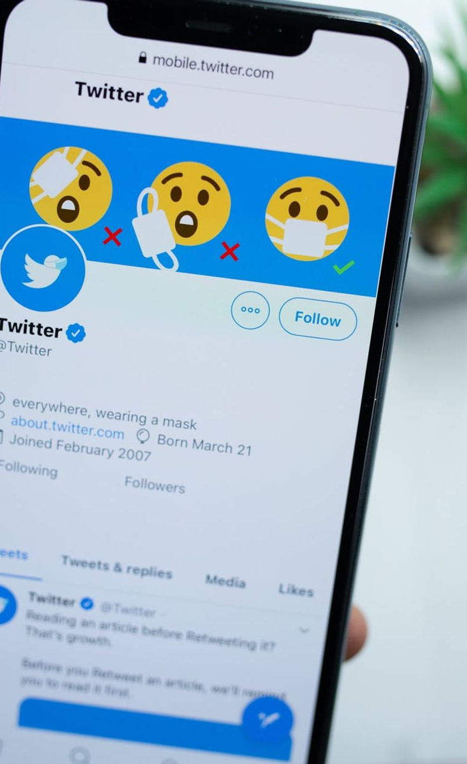


CANDIDATE MALPRACTICE
Examples of malpractice
Having or sharing details about exam questions before the exam – whether you think these are real or fake
Not telling exam boards or your school/college about exam information being shared.

Slide 22


CANDIDATE MALPRACTICE
Examples of malpractice
Bringing into the examination room or assessment situation unauthorised material, for example: notes, study guides and personal organisers, own blank paper, calculators (when prohibited), dictionaries (when prohibited), watches, instruments which can
capture a digital image, electronic dictionaries (when prohibited), translators, wordlists, glossaries, iPods, mobile phones, MP3/4 players, pagers, or other similar electronic devices;

Slide 23

Sanctions applied against candidates
The exam boards will decide on the application of a sanction according to the
evidence presented, the nature and circumstances of the malpractice, and the
type of qualification involved:
Warning
Disqualification from all units
in one or more qualifications
Loss of all marks for a section
Disqualification from a whole
qualification
Loss of all marks for a
component
Disqualification from all
qualifications taken in that
examination series
Loss of all marks for a unit
Disqualification from a unit
Candidate debarral
Unless barred from future examination entry, candidates may retake
a component, unit or qualification in the next examination series

Slide 24
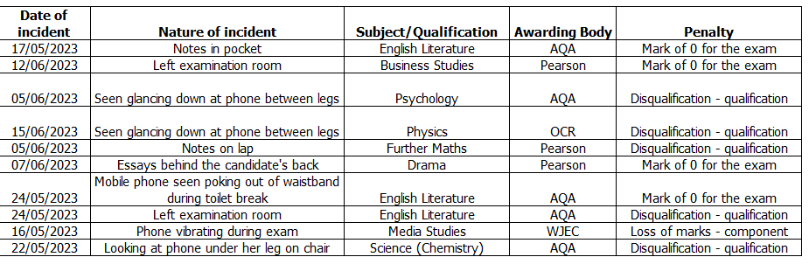

Slide 25
The Summer Term

Slide 26
Study Leave?
Is there Study Leave?
The short answer is no. Students will remain in lessons for as long as possible. We anticipate a 3 phase approach to lessons in school:
Phase 1 – normal lessons continue, students attend exams. If subjects have finished, students will have the opportunity to revise for other subjects in those lessons.
Phase 2 – normal lessons continue for the subjects that have not finished. If many subjects have finished, students will have the choice to use a year 11 Study Hub to work independently on revision.
Phase 3 – students prepare for exams at home and come to school for exams with the study hub still available.
We have not decided on dates for the different phases yet, but will confirm these as soon as we can. We do not expect phase 3 to start until early to mid-June at the earliest.

Slide 27
Last day?
When is the last day?
The short answer is whenever their last exam is.
We know the ‘last day’ for many students is a day to celebrate and sign shirts etc.
We want to celebrate with them too and will hold an event after the exams have finished to do this. We will confirm the date as soon as we can.
We do not expect students to sign shirts or celebrate before then.

Slide 28
GCSE Results Day
GCSE Results Day
Thursday 22TH August 2024
*Make sure that you are in contact with the school*

Slide 29
Hoody update
Hoody update
Students are not required to buy, but most do. There will be a deadline and then the order will be sent off, any payments not received by the deadline will unfortunately miss out. Please look out for an email from us this week.

Slide 30
Good Luck Messages
Link will be sent home after Easter
Students will be given these the week before their first exam
Please do not tell students

Slide 31
Post 16

Slide 32
Guidance Meetings
All Year 11 students – regardless of if you have applied to Hayes or not – it is about your progression to your next steps.
It is a 15 minute meeting with a member of staff regarding your next steps and what you need to do to get there.
This is NOT an interview – it is an opportunity to ask questions, change subjects if you want, and get advice/support if you want to go somewhere else.
It will also contain a review of your academic tutoring targets.

Slide 33
Guidance Meetings
Letters with time slots and staff have gone home.
If you cannot make the session, please email us at 6thadmissions@hayes.bromley.sch.uk
We will rearrange the slot for you.

Slide 34
The Summer
Induction days 8th and 10th July – Students will be invited to one of these. ‘Try before you buy’.
Parents Induction Evening – Wednesday 10th July 6:00pm – 7:00pm.
Around this time we will send out the ‘Bridging Units’ which will help to upskill students ready for September.

Slide 35
Results Day – Thursday 22nd August.
If you have met BOTH the ‘General’ and ‘Subject Specific’ Entry Criteria you will be asked to confirm your place by 5:00pm on results day – this is so we know the places we have on course lines.
If you have not met EITHER or BOTH the ‘General’ and ‘Subject Specific’ Entry Criteria you will be asked to come to school from 8:00am on Friday 23rd August to discuss your entry into Sixth Form and/or courses which are available to you.

Slide 36
Group 1 – students who meet the general and subject entry criteria.
Student has met the conditions of their offer and is on their first choice courses.
Group 2 – students who meet the general criteria but not the subject entry criteria.
Student has met the conditions for entry into 6th Form – but would need to discuss course options.
Group 3 – students who have not met the general entry criteria.
Student will be unable to join Hayes Sixth Form – but will be supported with next steps/careers conversations.

Slide 37
FAQ’s
Can I change subjects?
Yes – you can change up to an including induction days in the summer – after this your options are fixed until results day.
Can I change subjects on results day?
Maybe – it depends on if there is space on the course for you – this is likely to be the day after result that we can confirm this. .
Is induction compulsory?
No – however it helps to give you an idea of the subjects you will be taking.
How can I prepare for 6th form?
Speak to your teachers of the subjects you want to do. We will also give you ‘Bridging Units’ to look at over the summer which will prepare you for 6th form. It’s a really good idea to complete these – they will upskill you in the area.
What happens if I don’t get the grades for my subjects?
We will support as best we can getting you into sixth form – it is often best to have a 4th reserve subject just in case. Last year 97% of students made their first choice subjects. But ‘General Entry’ criteria are the most important thing.
Does 6th Form have the same rules as Year 11?
Some – we are still part of the school and follow the same rules, we expect our 6th Form students to be role models and have exemplary behaviour– but you can leave in your non-contact periods – as well as use your mobile in the Sixth Form Centre.
What are non-contact periods, period 11 and period 12?
You start studying 3 -4 subjects – meaning you will have 30-40 hours per fortnight with teachers out of 54. The rest is for you to be independent and be in control of your school day – you can use non-contact periods for homework or socialising. But Period 11 and Period 12 are timetabled study periods that you must attend and complete work set by teachers – these are held in silent study.
Can I apply to more than one 6th Form.
Yes – it is good to have a backup – you can accept multiple offers and then decide on results day where you are going.

Slide 38
