Slide 1
Progression - Art
‘A’ LEVEL ART and DESIGN 2026
Contents:
What areas of Art & Design can I study?
Where should I start?
Equipment List
Reading List Tasks
Welcome to A Level Art
Now that you’ve decided to study Art at A Level, you’ll need to do a bit of preparation. This pack contains information regarding the course structure, the summer project, suggested equipment list and websites to prepare you to start your A level in September.
The purpose of A Level Art is to develop knowledge and understanding of:
-Specialist vocabulary and artist terminology
-Theoretical research of a particular genre style and/or tradition
-In-depth understanding of a variety of media, techniques and processes
-Development of an idea, concept or issue
-Recording ideas and observations related to chosen lines of enquiry
-Communicating a particular meaning, message, idea or feeling

Slide 2
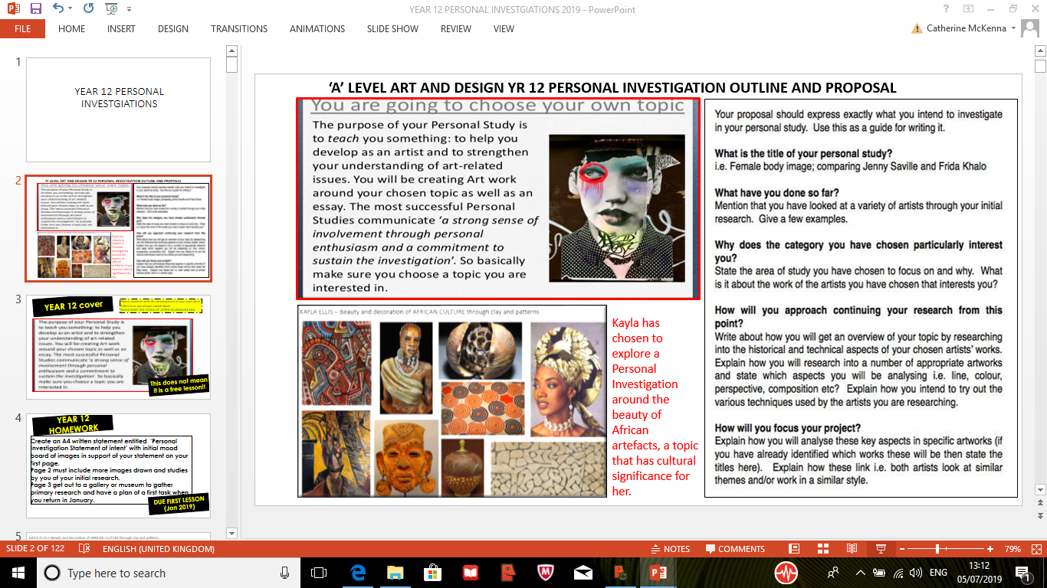

Slide 3
What do I have to do in A Level Art?
There are two components of the course- the personal investigation and the externally set assignment. The table below summarises the evidence you will produce for each component:
A Level Components | What will I need to do? | How will I evidence this?
Personal Investigation (coursework) 60% | -Write a personal study (essay) based on your chosen theme -Create a body of work related to a chosen theme/s -Create a final piece/s | -An essay 1,000 - 3,0000 words -Research on a range of artists and/or designers -Exploration of a variety of media, techniques and processes -Development of ideas in response to chosen artist/s/theme -Recording of ideas and observations
Externally Set Assignment (Exam) 40% | -Create preparatory studies based on the theme -Create a personal outcome/s in 15 hours of sustained focus | -By creating a body of work based on the theme given. This will include research, ideas, exploration of media, development of ideas and a final piece/s.

Slide 4
The table below summarises tasks you will need to do to meet each of the four assessment objectives:
Development of Ideas | Exploration of Media | Recording & Reflecting | Personal Response
-Research a range of artists- collect images, make a visual study, include biographical information and analyse their artwork -Create your own ideas inspired by your chosen artist/s -Show a clear development of ideas- have they been manipulated, transformed and edited throughout the journey | -Explore with a wide variety of media, techniques and processes -Continually review and refine your work- consider the potential and the limitations of the media used | -Take own photographs related to chosen theme/idea -Create a range of observational studies from primary and secondary sources -Use annotation to explain your idea/s and to reflect on your progress | -A final piece plan to document intentions for final piece and explanation -A final piece/s that realises what you intended to do

Slide 5
Where should I start?
You need to think about the following:
• What subject/ theme are you most passionate about?
• What is it about this subject that is interesting?
• What other avenues could this branch into?
• Will you be able to sustain this theme for a long period of time?
• Can you think of any particular artists that could relate to it?
• Are there any particular styles or techniques that you can explore with?
• Are there any current galleries, exhibitions or events that could be relevant?
• What places, objects or things could you collect or photograph?

Slide 6
‘A’ LEVEL ART and DESIGN 2025
Component 1:
Summer Bridging Unit
‘Preparation for The Personal Investigation’

Slide 7
Summer Project
Over the holiday, you will need to complete the following tasks:
❑ To select a theme you are passionate about- this could link to people, places, objects,
natural world, environment etc.
❑ Visit a gallery or exhibition and document this- photos, drawing, notes, sketches, ticket etc.
❑ To collect images and take photographs related to your theme-whole images, sections, close
up etc.
❑ Create a range of drawings and studies from these and life using a range of different
materials and techniques-try as many different ones as possible!
❑ Find 2 artists that interest you- it could be their style, use of colour, materials they use etc.
Document their work- a copy of their artwork, write some notes to explain it and include
biographical information that is relevant.
❑ Create a variety of studies from your sources but now try them in the style of your chosen artists- consider the artists style, technique and use of media etc.
❑ Use notes/annotations to support your work so far- this could include explanations or
reflections.
Document your project in any format you wish- sketchbook, sheets, folder, concertina etc.

Slide 8
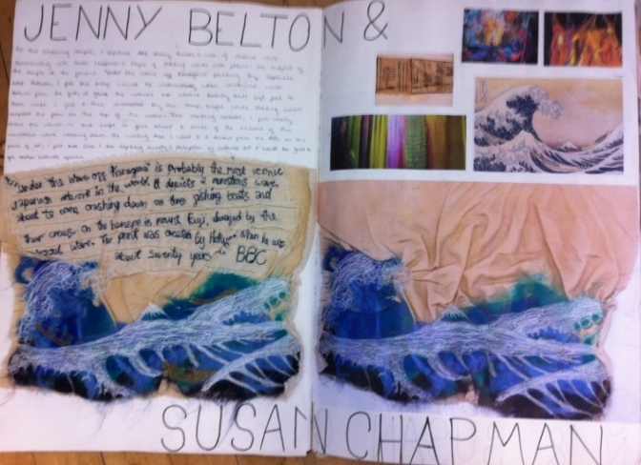
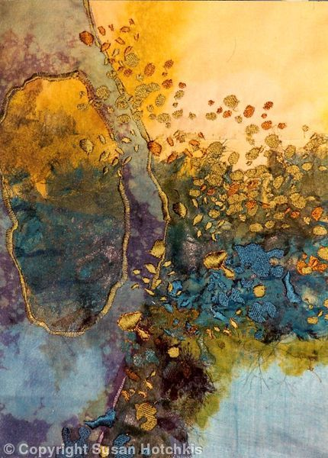
Task 1: ART APPRECIATION- Gallery/Exhibition Visit
You must visit a gallery, museum or exhibition over the summer holidays and research a selection of art/textiles/sculptural work which you are inspired by.
Take photographs of the work and buy some post cards.
In your sketchbook you must dedicate at least one double page of write up with own illustrations. Present your studies and write in our own words discussing …
Why you chose this particular piece of work. Who is the artist & when was the piece made? What is the title of the work. What art media, textile materials etc. has the artist used to make this work. Discuss any overriding themes that the artist is exploring and how it might link to your own Personal Investigation.
Give your own personal views and opinions to thoroughly analyse and evaluate.
Task 2: ARTISTIC RESPONSE
Make at least TWO PERSONAL Textiles and or Fine art responses to work by using a range of Art and Textile materials that you have to hand over the holidays.
Present your responses in your sketch book. Analyse and evaluate your outcomes with detailed and descriptive personal comments, views and opinions.
REMEMBER TO INCLUDE KEY ELEMENTS IN YOUR ANNOTATIONS:
CONTENT, MOOD, THEME, COMPOSITION, TECHNIQUES, USE OF MEDIA AND MATERIALS AND HOW AND WHY THIS WORK COULD LINK TO YOUR OWN FUTURE PERSONAL INVESTIGATION.
Be inspired by the richness and variety of Art around you. Good Luck and do your best.
Ms McKenna, Mrs Maides and Mrs James.

Slide 9
Equipment List
Please find below a suggested list of materials for A Level Art:
❑ A3 Sketchbook
❑ A selection of drawing pencils-(B, 2B, 4B etc.)
❑ Masking tape
❑ Acrylic paint
❑ Watercolour palette or tin
❑ A selection of paintbrushes- (soft and stiff bristle)
❑ Pastels- soft/oil
❑ Soft coloured pencils or watercolour/Aquarelle
❑ Charcoal- compressed or pencil
❑ Selection of inks
❑ Selection of pens- fine liners
Equipment
All students must have a basic art/ textiles kit. You should put your own together before the start of the course. For Art this should include a drawing pencil set, rubber, and sharpener, drawing pens, acrylic paints/oil/chalk pastels, paint brushes sizes 2,4,6, 8; a selection of A3/A4 plain coloured paper/card and A3 sketch books etc.
For Textiles you will need embroidery needles, threads, fabric paints, beads, selection of coloured printed fabrics, A4 Pink Pig sketchbook
Every student must contribute the sum of £20 to cover the costs of the sketchbooks and general art/textiles equipment and colour photocopying at the beginning of the course.

Slide 10
Suggested Reading
Websites: https://www.studentartguide.com/ https://www.theartnewspaper.com/ https://www.artforum.com/ http://www.artnews.com/ http://artreport.com/ http://www.tate.org.uk/art/artists/a-z https://www.artsy.net/artists https://artuk.org/discover/artists

Slide 11
Books:
Thinking About Art: A Thematic Guide to Art History by Peter Huntsman (2015)
What Are You Looking At? 150 Years of Modern Art in the Blink of an Eye by Will Gompertz (2016)
Think Like an Artist by Will Gompertz (2015)
Looking at Pictures by Susan Woodford (2018)
The Art Book by Tom Melick (2014)
The Art of Creative Thinking by Rod Judkins (2015)
100 Artists’ Manifestos from the Futurists to the Stuckists by Alex Danchev (2011) textiles examples
Reading List Tasks:
• Collate notes about key subject matter, record quotes and any other relevant information. • Create a visual mind map of key ideas. Use drawings, images and photographs to illustrate this. • List key terms and vocabulary- research meanings and/or context. • Write a list of key questions and/or discussions points that are raised.

